Slide 1
SparkING
Empower customers with personal, relevant and fast interactions
Bas Geerdink
Ger van Rossum
Hoda Alemi
Jaap de Koning
Khaled Tokhi
Niek van de Pas

Slide 2
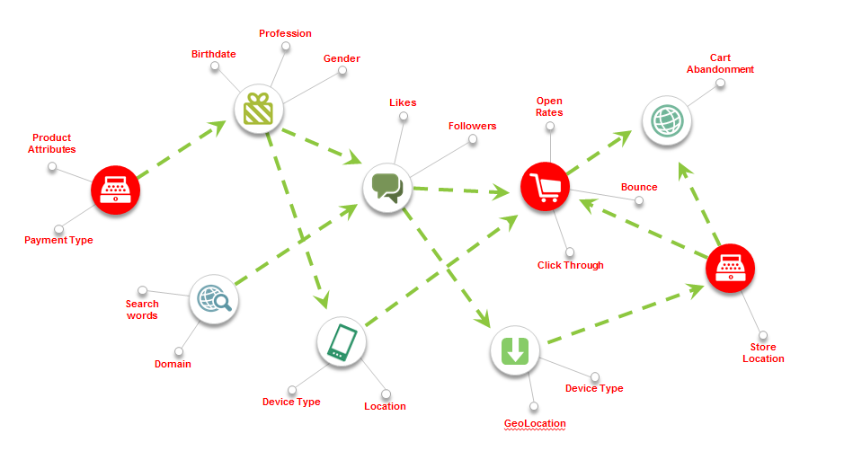
CJ Touchpints

Slide 3
A customer journey…
Marie is 42 and lives in Amstelveen. She wants to move with her family to Enkhuizen!
Marie has a mortgage of 250.000, her current balance is 300
Marie is at home, looking at websites of houses for sale and mortgage providers.
When she opens the ING site, she immediately gets an interesting offering for a mortgage advisory meeting in her neighborhood!

Slide 4
… the journey continues
After making an appointment online with the ING advisor, Marie goes out for shopping
She buys some groceries and household equipment, for 62 euros
She also buys a nice pair of jeans for 95 euros
Marie then sees the latest model iPhone, she wants it!
Sensible as she is, Marie opens her mobile ING app, there she immediately sees the effect that such a large purchase would have: she will have a negative balance at the end of the month.
ING presents her the option to take money of her savings account, but she decides she’ll get the iPhone next time.

Slide 5
How is this possible?
Traditional ‘Static’/batch data from ING’s backend systems provide insight into Marie’s financial situation.
This data is combined with real-time data from the websites she visits and her current location
The application knows that Marie is interested in houses and mortgages. So, the content of ING’s homepage is adjusted to her needs.
When she goes shopping, the same happens with different real-time data: she is at a shop, she has recently made some purchases.
Now, it’s far more likely that Marie is interested in her account balance, forecasted financial situation and maybe even offerings for short-term loans!

Slide 6

State-of-the-art architecture and design patterns
Lambda Architecture (combining batch & real-time)
In-memory Analytics
Fast data processing with Actors
CJ touchpoint/omnichannel principles

Slide 7





Technology stack
Data Sources
Rule Engine
Prediction Engine
API
App
Website

Slide 8
So, what for customers?
Relevant, personal intreactions NOW!
Personalized content
Real-time updates, pushed if necessary

Slide 9
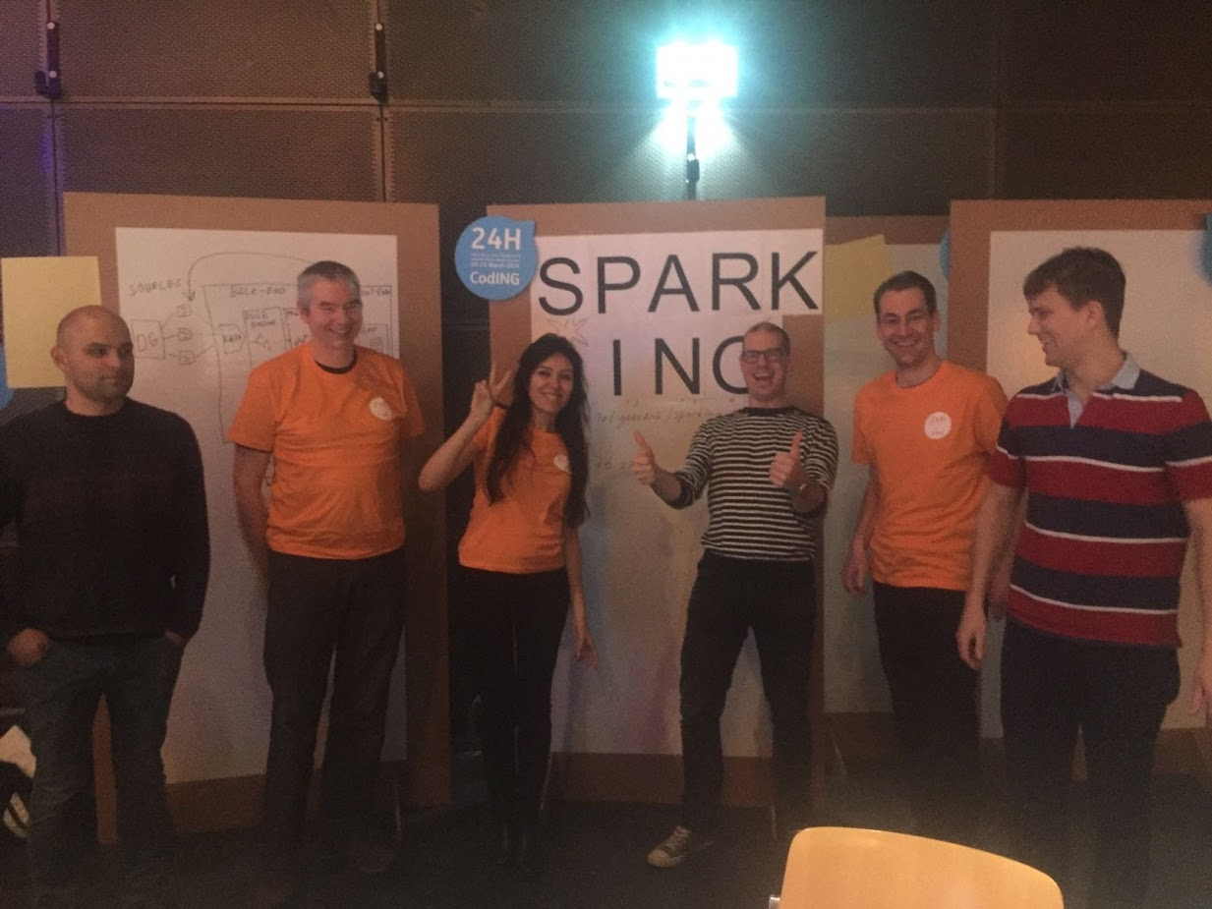
And this is our team! ☺

